Slide 1


Data Science Bootcamp
Baigal & Flaude

Slide 2


Prédire la production & la consommation d’énergie

Slide 3

Objectif :
Construire un modèle de Machine Learning qui prédit la production et la consommation triennale d’énergie d’une installation solaire résidentielle.

Slide 4

Project idea
Future of energy:
The world is in a transition to new kinds of energy:
Blockchain enabled software platform for trading renewable energy and environmental commodities.
The peer-to-peer nature of blockchain could provide a particularly useful answer to the existing problems we see within energy networks around the world.
“Energy independence is new independence.”
Image source

Slide 5
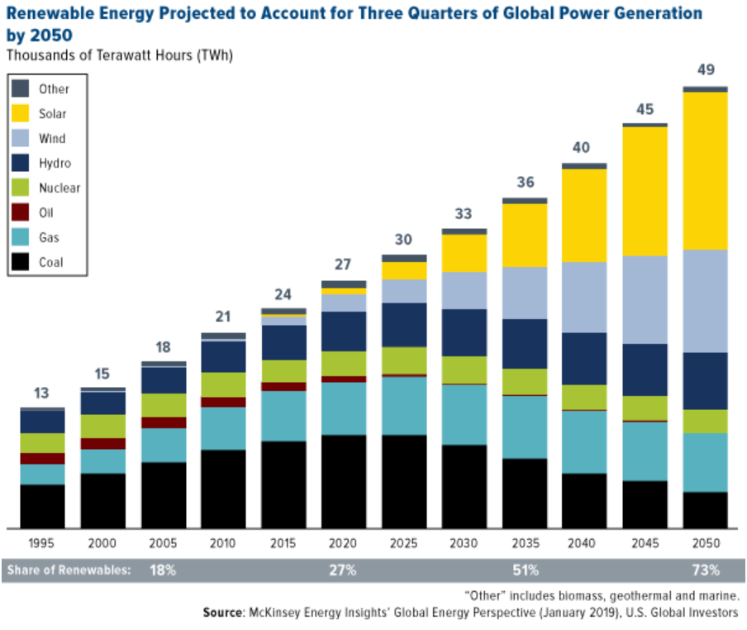
Contexte :
Transition énergétique.

Slide 6
Méthodologie adoptée:
Recherche les données
EDA
Modélisation
Feature selection
Résultats
Conclusions

Slide 7
Recherche les données

Slide 8

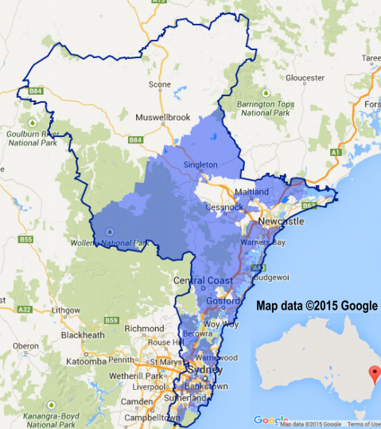
Les données
Les données de ce projet proviennent de l’API de Ausgrid et concernent concernent 300 foyers équipés de systèmes solaires sur le toit.

Slide 9
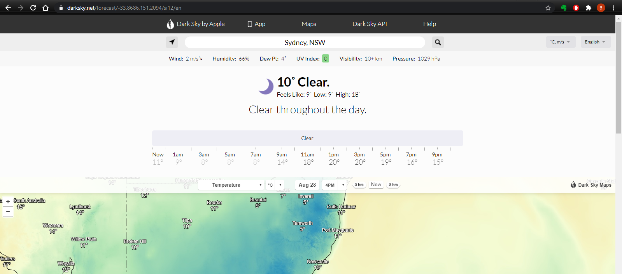
Pour les données météorologiques
Nous avons utilisé les informations météorologiques de DarkSky.net. Nous avons fait du web-scraping pour obtenir 3 ans de données météo, température, indice UV, neige.

Slide 10
EDA

Slide 11
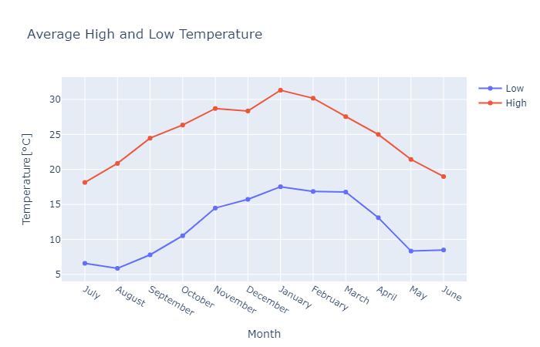
Average High and Low Temperature

Slide 12
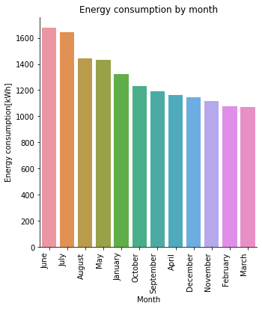
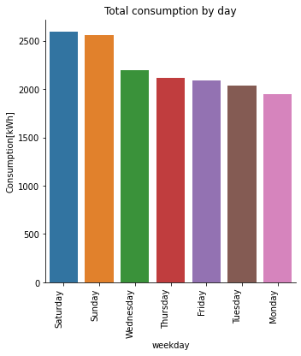
Energy consumption by month, by week

Slide 13
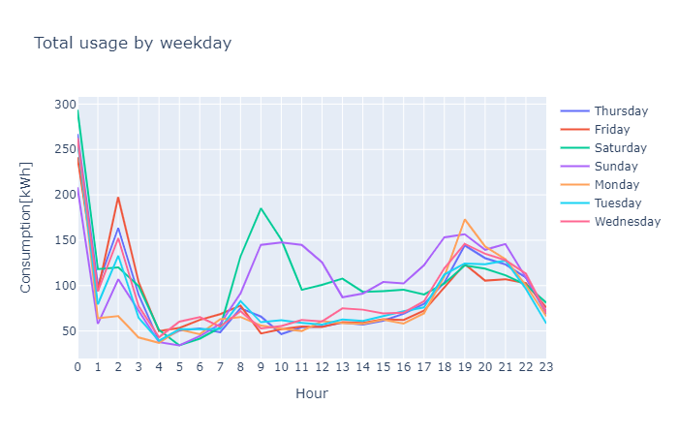
Energy consumption by week and weekend
WRONG

Slide 14
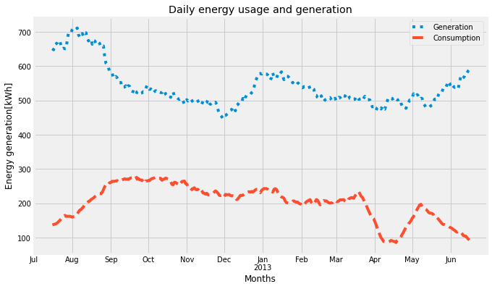
Daily energy generation and consumption
WRONG

Slide 15
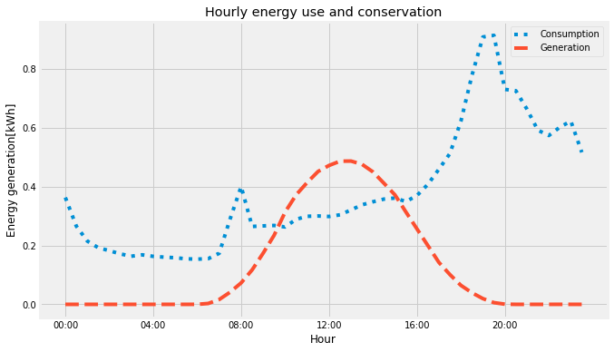
Energy generation and consumption hourly

Slide 16
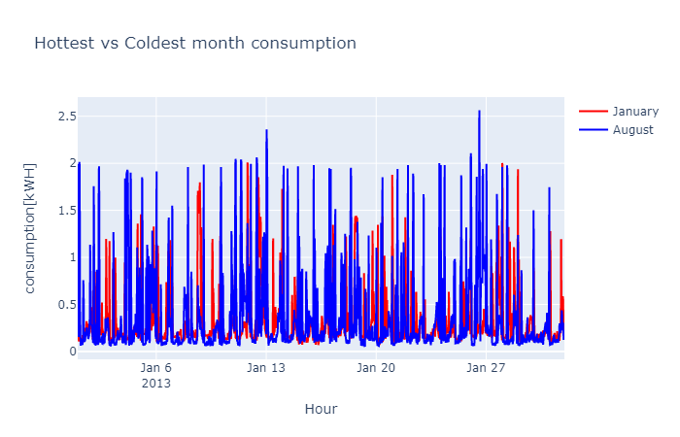
Hottest vs Coldest month consumption

Slide 17
Energy generation and features

Slide 18
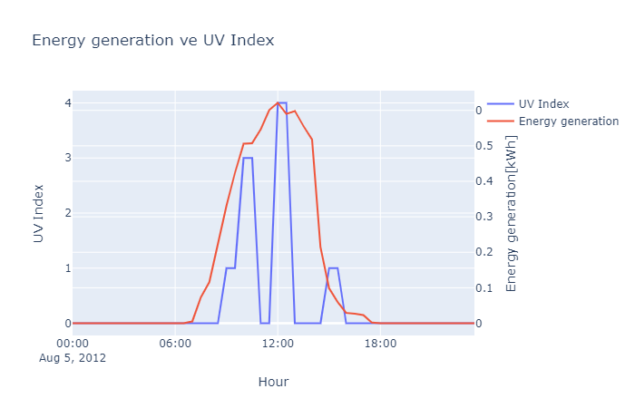
Energy generation vs UV Index

Slide 19
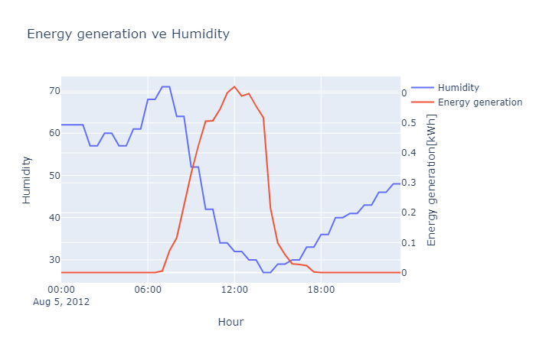
Energy generation vs Humidity

Slide 20
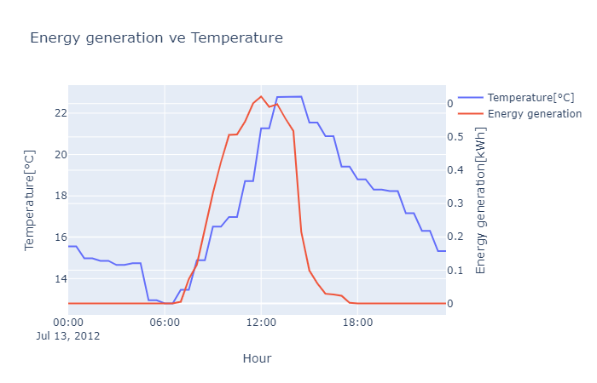
Energy generation vs Temperature

Slide 21
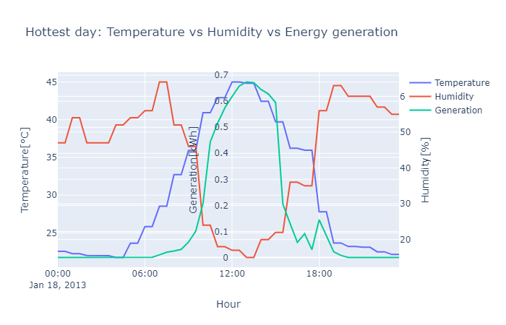
Temperature, humidity and generation

Slide 22
Modélisation sur la production d'énergie

Slide 23
Feature selection

Slide 24
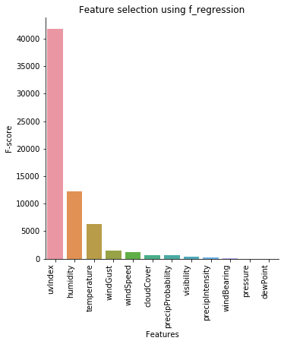
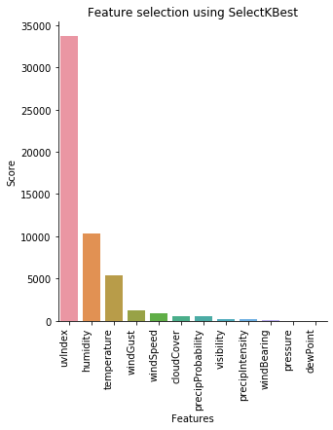
Feature selection
Nous avons utilisé 2 méthodes de sélection des features:
Most important feature (LR)
SelectKBest method

Slide 25
Modèles et Résultats
Model | Before Feature selection |  | After Feature selection
Score | R2 score | RMSE | R2 score | RMSE
Linear regression | 0.23 | 0.23 | 0.23 | 0.23
Random Forest | 0.23 | 0.23 | 0.23 | 0.23
XGBoost | 0.23 | 0.23 | 0.23 | 0.23

Slide 26

Modélisation sur la consommation d'énergie
source

Slide 27
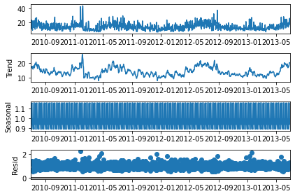
Forecasting Time series
Why time series is special?
Level: The baseline
Trend: Behavior of the series over time.
Seasonality: Repeating patterns or cycles of behavior over time.
Noise: Variability in the observations
Stationarity: A time series is stationary when the mean, variance, and autocorrelation are constant over time
ARIMA model

Slide 28
Forecasting using these models
ARIMA
SARIMAX
LSTM (deep learning)
Facebook’s Prophet

Slide 29
Modèles et Résultats
Modèle | RMSE[kWh]
ARIMA | 5.4
SARIMAX | 4.1
LSTM | 3.8
Prophet | 5.5

Slide 30
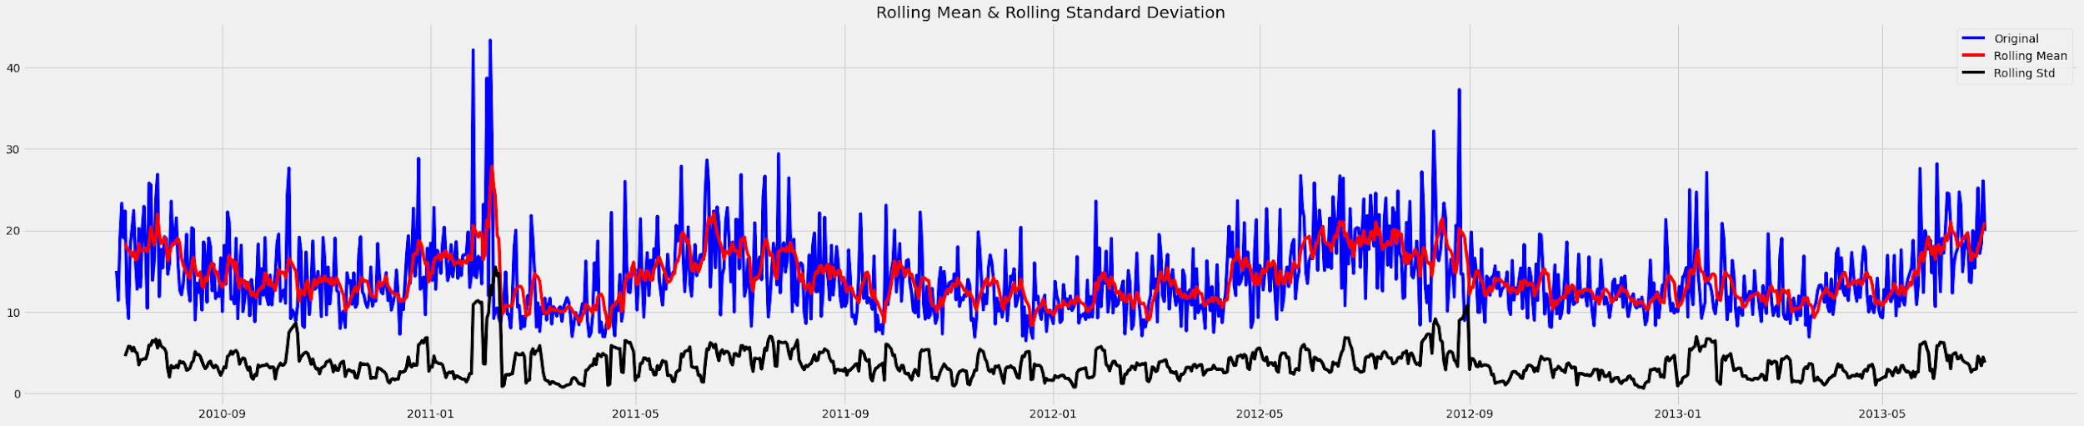
ARIMA model
Important parameters:
Seasonality:p Auto-regressive aspect of the model, which incorporates past values.
Trend:d Integrated part of the model. Effect the amount of differencing to apply to a time series
Noise:q Moving average part of the model

Slide 31
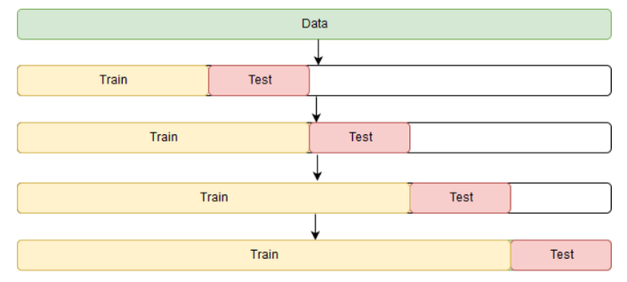
ARIMA model
Find best parameters: auto_arima (GridSeachCV in arima)
Window rolling technic

Slide 32
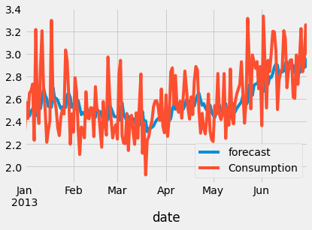
ARIMA modeling result
Model gets the trend and level. But not much accurate in terms of highest and lowest points.
Prediction vs actual consumption

Slide 33
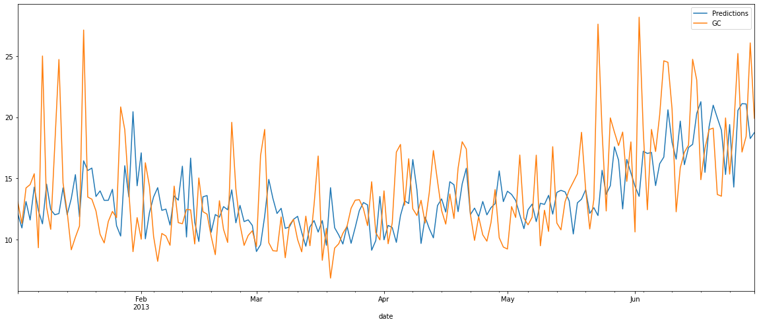
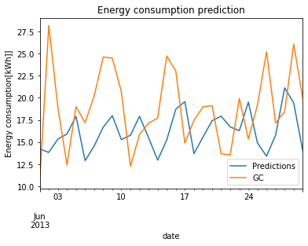
SARIMAX model
ARIMA model with SEASONALITY
Train set
Test set (prediction)

Slide 34
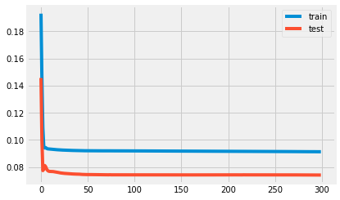
Naive LSTM model
Most simple LSTM model with 2 layers(input 100), 1 Dense layer (output 1), loss function:mae, optimizer:adam.
Loss in train, test set

Slide 35
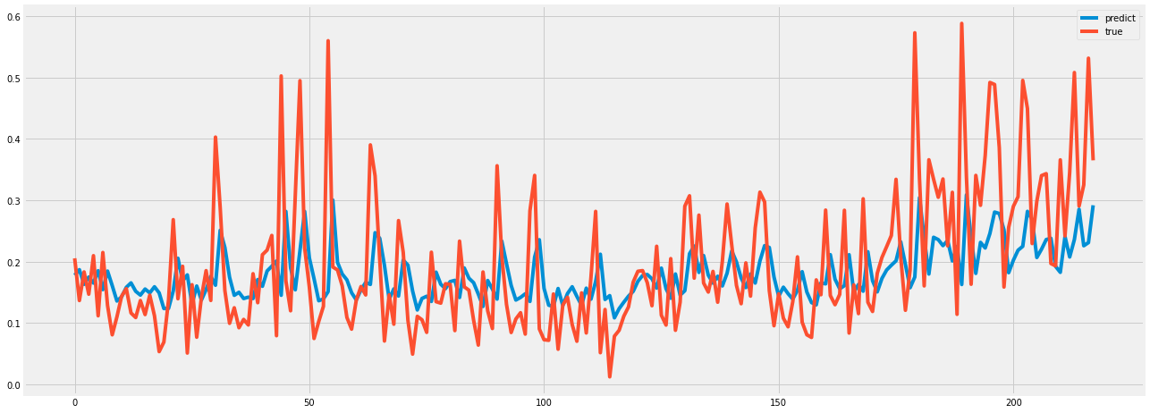
Naive LSTM model result
Result in test set

Slide 36
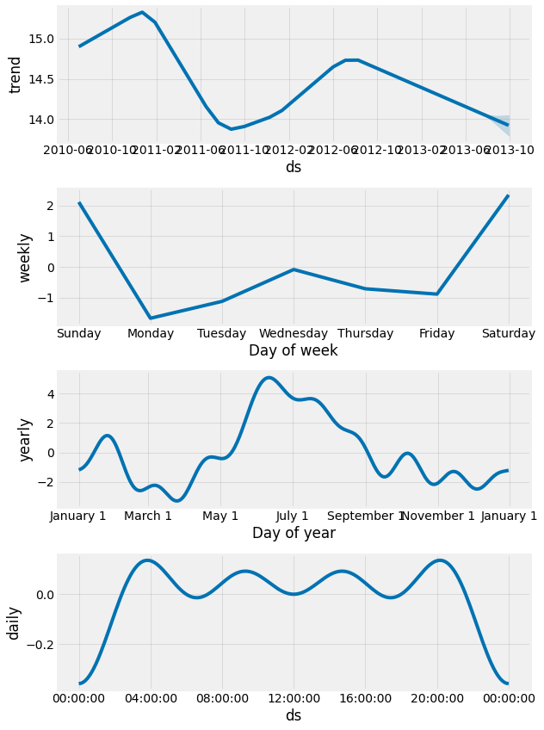
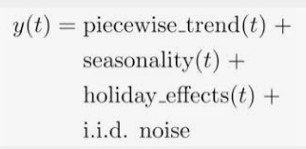
Facebook Prophet
Prophet uses models trend, seasonality and HOLIDAY effects, and irreducible error.
Prophet
Decomposition

Slide 37
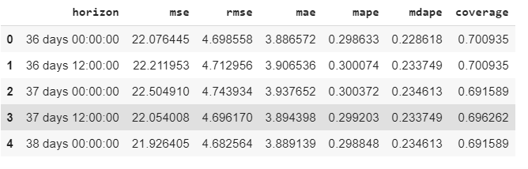
Facebook Prophet
We can see more detail in Prophet result!
Prophet result

Slide 38
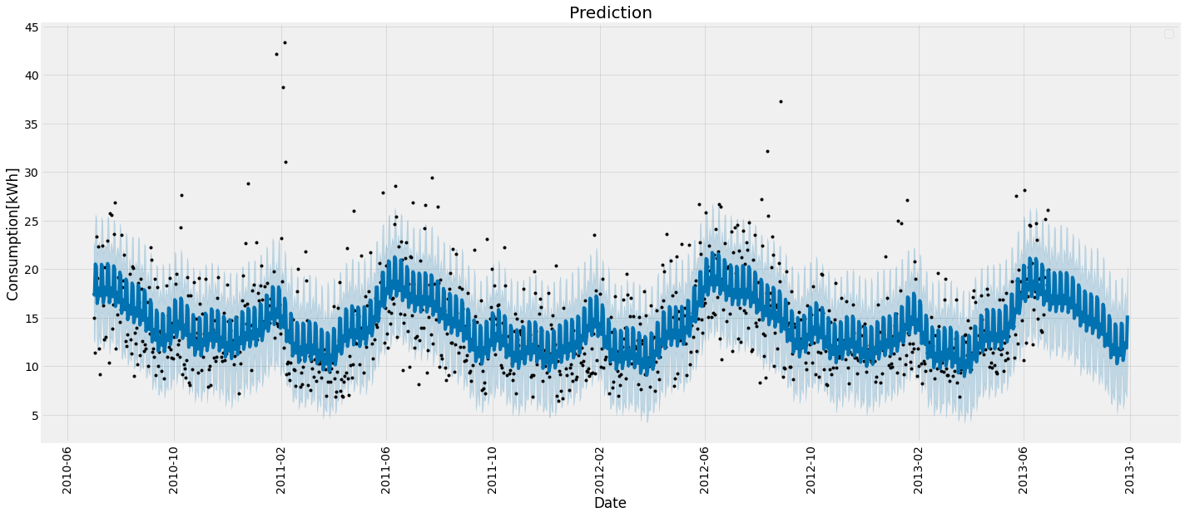
Facebook Prophet result
Prediction

Slide 39
Conclusion & Perspectives

Slide 40
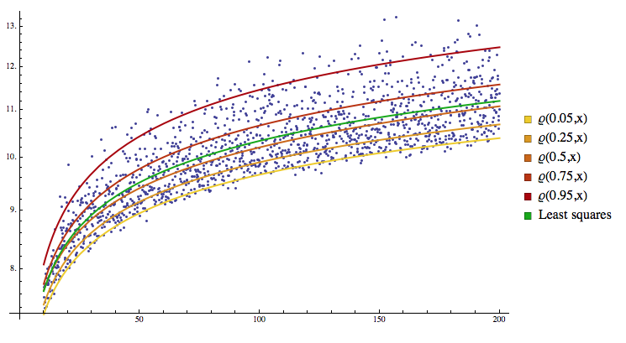
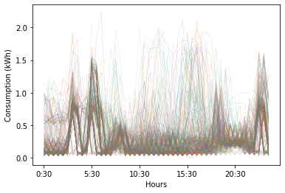
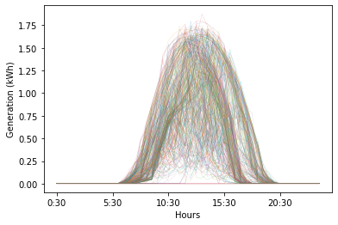
What we didn’t do:
Use quantile regression K-near neighbors method to find 300 household energy consumption and generation

Slide 41
Merci pour votre aimable attention !
Question(s) ?

